Slide 1



Decoy Community Primary School
Inspiring Positive Futures
New Reception Parents
Information
2020

Slide 2
Welcome to Decoy Community Primary School
This PowerPoint presentation is designed to give you the information that we would normally present on an informal evening at our school. Unfortunately, given the current circumstances, we are unable to do this with you this year.
We intend to share as much information remotely with you as we possibly can so that you, and your child feel confident about starting school in September. Should you have any further questions or concerns, staff will be more than happy to discuss these with you.
The school website decoyschool.co.uk is kept up to date with the latest news and events and has lots more information about our school.

Slide 3
The Reception classes at Decoy Community School
The Reception classes are called Ladybirds and Dragonflies.

Slide 4
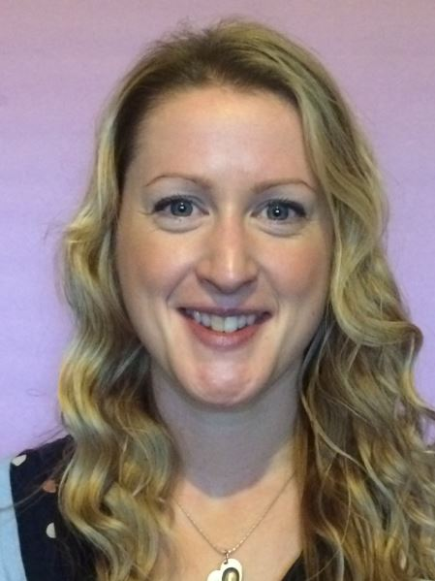
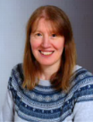
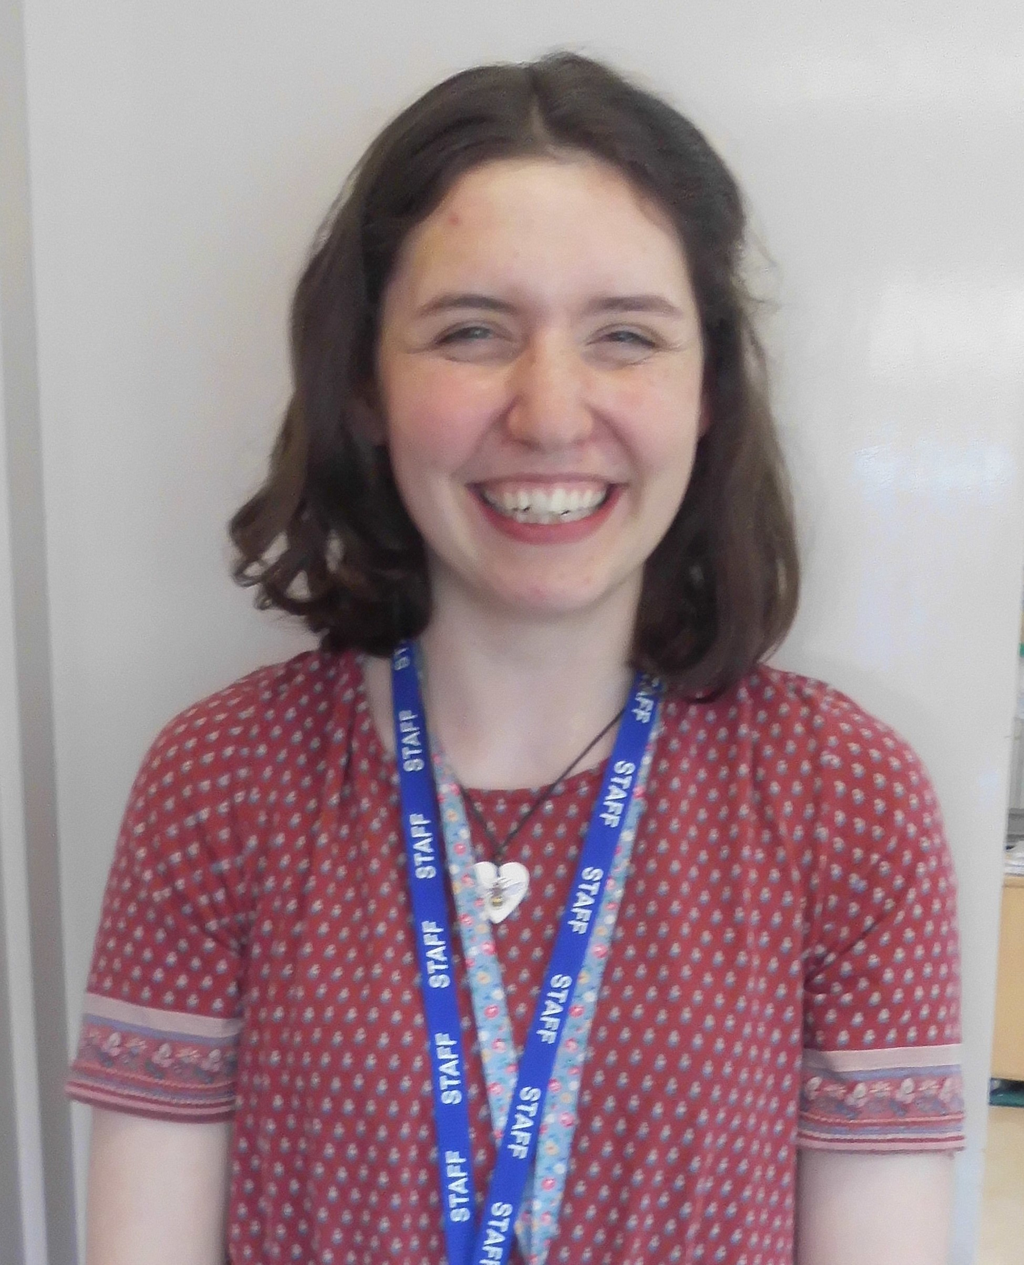
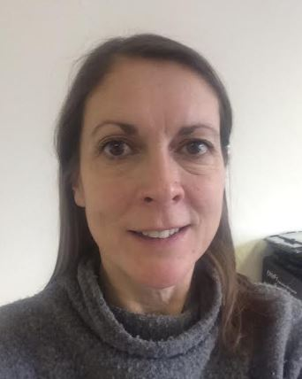
Meet the Reception Staff
Mrs Smith is the Early Years Team Leader and also teaches in our Nursery.
This is the team who work in Reception. The teachers are Miss Fraser, who works in Ladybirds and Mrs Cammack and Mrs Potter who work in Dragonflies. The teaching assistants are Mrs Cogavin, Mrs Bull, Mrs Jones and Mrs Yip. We will introduce ourselves via video for you to share with your child soon.

Slide 5

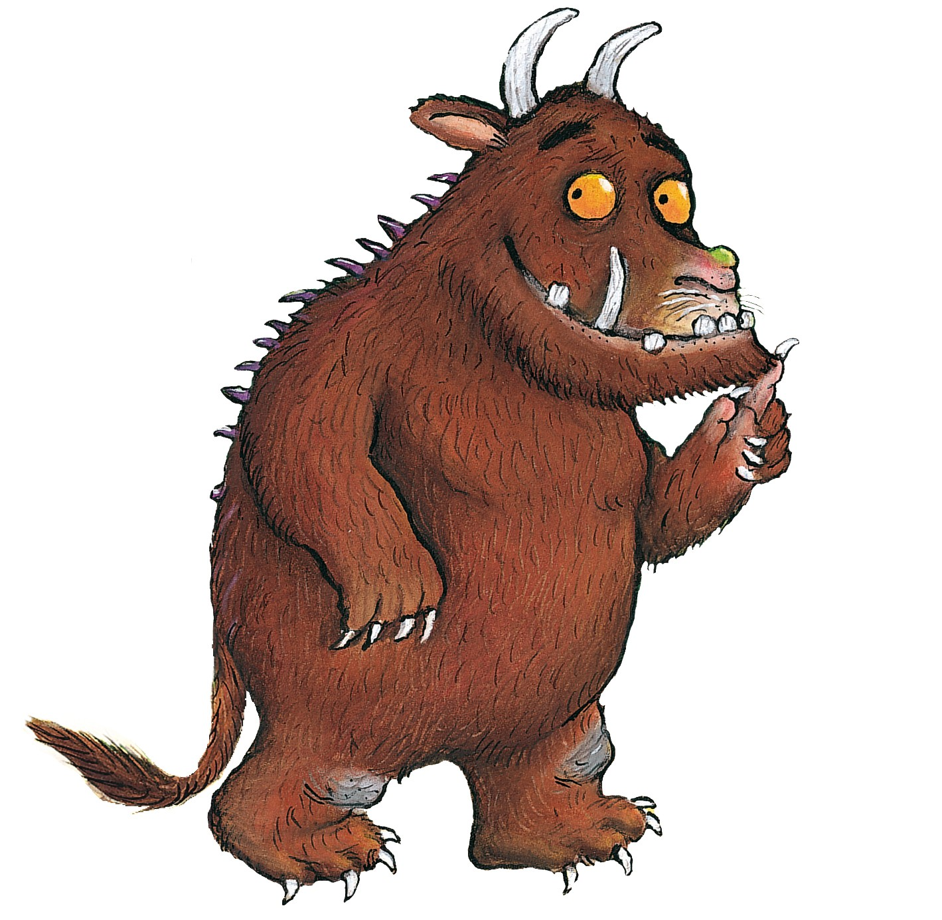



Groups in Reception
There are 5 groups in the Reception Classes. Both classes have the same groups and children work in group time with their friends within these groups.

Slide 6

Food and Drink
Lunch: At lunchtime your child can have a packed lunch prepared
at home and brought into school, or a school dinner.
All early years and Key Stage 1 children are entitled to a free school meal each day. Packed lunches should support our school’s healthy eating policy. Please note that our school is a ‘nut free’ zone which means that all types of nuts are banned. Also note that fizzy drinks and sweets are not allowed in school lunches.
Snacks: Children will receive a free piece of fruit/healthy snack during the day. We also have a snack café in the morning where we provide different food for the children to prepare for themselves. This can include milk shakes, smoothies, fruit salad, toast, sandwiches and cereal.
Drinks: Water is available throughout the day, including lunchtimes. Children can also bring a drink to school – remembering that no fizzy drinks are allowed and ensure all drinks bottles are labelled.

Slide 7

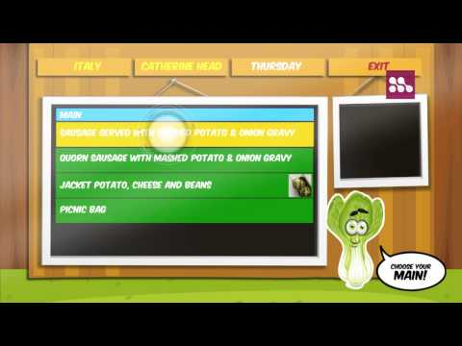
School dinners
We use the system cypad to order
school dinners.
There will be a selection of different meals available each day for your child to choose from. Vegetarian options are always available. Please let us know if your child has any other dietary restrictions or requirements.
There is always a hot dinner option,
a deli bar option (wrap, roll or cold pastas with cheese, ham or tuna), a salad bar available and a packed lunch option.
It is important that you order a dinner the night before school. You can preorder up to a half term’s worth of lunches at a time. If this isn’t possible, the kitchen is open first thing in the morning to take orders on the day.

Slide 8
Daily Timetable and Important Dates
Daily Timetable: The school day starts at 8.55am and finishes at 3.20pm. We will share more information about the school day and how it will look in September as soon as we are able to.
Breakfast and After School Club is available. Children are collected from and dropped off at school by staff members.
Important Dates: Important dates and events are included in our regular newsletters and can also be found on our school website. As soon as we know the arrangements for September, we will inform you of your child’s start date and other important dates.

Slide 9
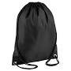
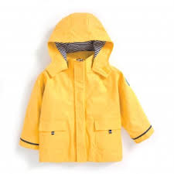
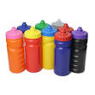

Trays and Pegs and Objects from Home
Trays and Pegs: Each child has a peg in the cloakroom
for PE bags and coats. Space is limited so please don’t
use rucksacks.
Drinks bottles go in the lobby.
There is also a tray for each group in classrooms to store book bags.
If your child did not attend Decoy First Steps Nursery, they will receive a book bag as a welcome gift from the school.
Objects from home: We would rather not have things brought in from home if possible. However, if your child wishes to bring in a toy or object from home, please ensure that it is named. If it is especially valuable or breakable please speak to a member of staff before leaving it in the setting.

Slide 10



Clothing
Clothing: At Decoy School all children wear a school uniform.
 | Winter Uniform | Summer Uniform | PE Lessons
Girls | Grey skirt, grey pinafore or grey trousers. White blouse or white polo shirt. School Sweatshirt or school cardigan. White socks. Sensible black shoes. | As winter / or Green gingham dress. Plain white or black sandals. | Black PE shorts and a white round neck T-shirt. Plimsolls or trainers. Tracksuit or jogging bottoms.
Boys | Grey trousers. White shirt or white polo shirt. School sweatshirt. Grey socks. Sensible black shoes. | As winter / or Grey shorts. Plain black sandals. | Black PE shorts and a white round neck T-shirt. Plimsolls or trainers. Tracksuit or jogging bottoms.
Please ensure that all clothing that your child wears or brings into school, is clearly named.
PLEASE LABEL EVERYTHING!
Notes:
Talk about labelling/ talk about green cardigans… not uniform! PE kit not needed until after half term.

Slide 11




School uniform suppliers
Below are four companies that all produce our uniform at excellent prices; all items have been viewed and are of great quality. Which one you use is up to you!
My Clothing:
Price and Buckland:
PMG Schoolwear:
School Trends:

Slide 12

Health
Health: Staff need to be aware of your child’s medical background, in particular any allergies (e.g. bee stings, dairy food), any dietary restrictions (e.g. vegetarian or Halal) and any medical conditions that are important for us to know (e.g. asthma or eczema).
Children can suddenly become ill and therefore it is important that we know we can contact you or another adult relative/friend at all times. Please ensure that the school is kept up to date with your contact details. If your child is unable to attend school due to illness, please telephone the school office to let us know.
If you are unsure about sending your child to school when they are ill please refer to the NHS website.
Sickness bugs require a clear 48 hours before returning to school.

Slide 13
Early Years Curriculum
Activities in Reception are carefully planned and organised in order
to provide a range of learning experiences. Individual records are kept by staff to record the activities your child participates in and undertakes, as well as their progress in specific skills.
Planning for each week is carried out using a topic-based approach, following the children’s interests and responding to specific events.
There are 7 Areas of Learning in the Early Years Foundation Stage (EYFS), which activities are planned around: Personal, Social and Emotional Development, Physical Development, Communication and Language, Literacy, Mathematics, Understanding the World, and Expressive Arts and Design.
Throughout the EYFS, children will be working towards the Early Learning Goals. These describe the level of attainment expected at the end of your child’s Reception year in school.

Slide 14
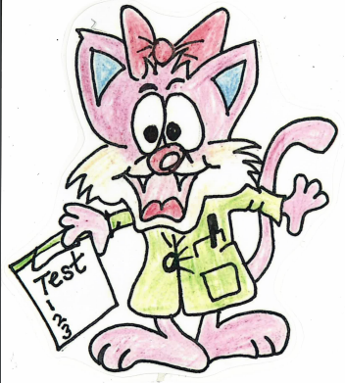
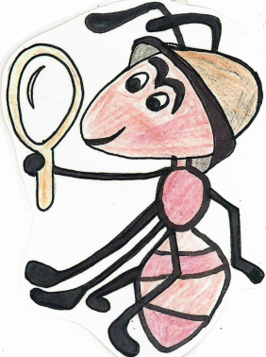
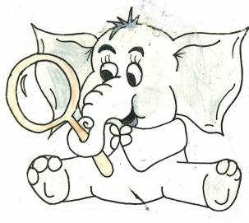
Characteristics of Effective Learning
The characteristics of effective learning underpin all the learning we do in Reception. These are creating and thinking critically, active learning and playing and exploring. To make these characteristics child friendly and something we can monitor and recognise the achievement of, we have given each characteristic an animal. These are:
Carla the Cat (I think carefully about what I learn, I work hard to solve problems)
Anthony the Ant (I try my best and never give up, I stick at tasks and persevere)
Ellie the Elephant (I explore everything around me, I ask questions and find things out)
We will celebrate children’s learning using these characters and your child may enjoy wearing a lanyard with the character on to recognise this during the school day. You will also see these characters on displays and we will refer to them in Tapestry observations. Similarly, if you notice your children using these characteristics at home, do let us know or add observations about them on Tapestry.
Notes:
Gill

Slide 15

Learning Journeys, Reports and
Parent Evenings
Throughout the year, staff will record your child’s learning online using TAPESTRY.
This will form a unique record of your child’s learning and development. It will contain samples of work, photographs and staff observations. This will enable staff to track your child’s progress and attainment, and also plan future activities.
Please see the pack for detail on how to sign up to Tapestry.
Reports – Reports are written in the summer
term.
There will be parents meetings every term to discuss
your child’s progress that term and to address any concerns you may have. However, we are always available after
school to talk to or you can phone the school and we will phone back when it is possible.
Notes:
Gill

Slide 16

Home Learning
We understand and value the support you provide for your child at home. Early years staff would love to hear about what you and your child have been doing at home. We encourage you to share your child’s learning, achievements and experiences with staff, as this helps us to build a more complete picture of your child. As parents and Carers you are encouraged to add your own observations to Tapestry.
Homework – We set weekly homework tasks that are very
informal and optional.
Notes:
Gill

Slide 17
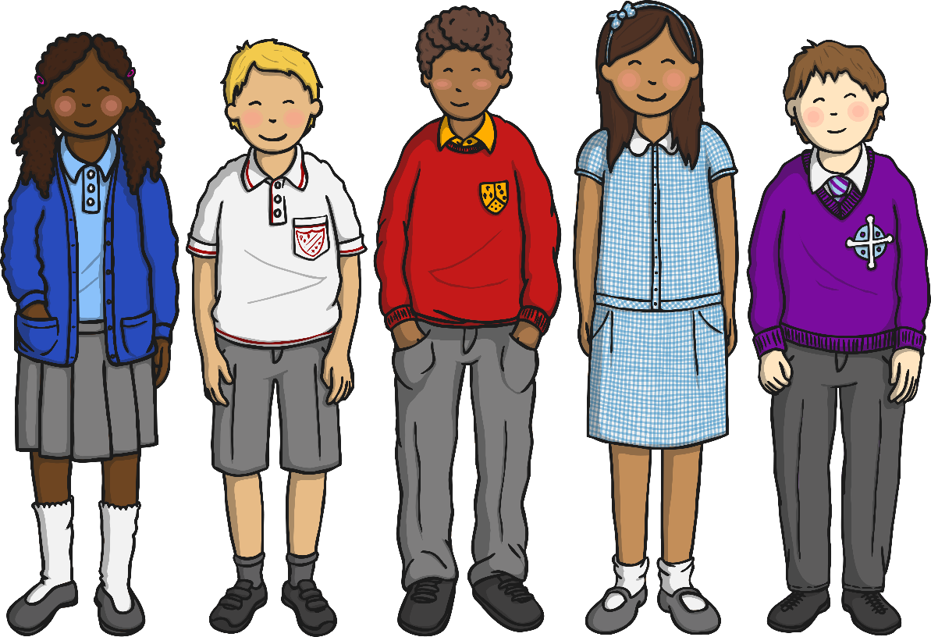
We hope that this presentation is useful. Should you have any questions, please feel free to email or phone the school.
We aim to ensure that your children’s experience in Decoy Community Primary School is a happy and rewarding one. We look forward to working with both you and your children.
Notes:
Gill

Slide 18

Decoy Community Primary School
Inspiring Positive Futures

